Slide 1


Seokhyun Yoon
21/NOV/2023

Slide 2

Outline
Executive Summary
Introduction
Methodology
Results
Conclusion
Appendix

Slide 3
Executive Summary
Using API will request the data through URL
Using Data wragling, process the data in a way we needed
Extract the necessary data from the dataset using SQL
Visualized data so that audience can understand the data
Build the interactive map
Build the dashboard
Notes:
Summary of methodologies
Summary of all results

Slide 4
Introduction
The data is mixed with the other payload model such as Falcon 1
Deliver data driven insights to determine if the first stage of Falcon 9 will land successfully

Slide 5

Section 1

Slide 6
Methodology
Executive Summary
Data collection methodology:
Using SpaceX Rest API
Perform data wrangling
Using API, get the response and transform from json into useful data
Perform exploratory data analysis (EDA) using visualization and SQL
Perform interactive visual analytics using Folium and Plotly Dash
Perform predictive analysis using classification models
Used a predictive model such as SVM, logistic regression and etc to find the best model

Slide 7
Data Collection
Data was collected using SPACEX rest API about launches:
Rocket used
Payload delivered
Launch specifications
Landing out comes
And more

Slide 8
Data Collection – SpaceX API
Present your data collection with SpaceX REST calls using key phrases and flowcharts
Add the GitHub URL of the completed SpaceX API calls notebook (must include completed code cell and outcome cell), as an external reference and peer-review purpose
device
API
cloud
Data storage
Notes:
Github url : https://github.com/DoubleOne7/coursera/blob/main/jupyter-labs-spacex-data-collection-api.ipynb

Slide 9
Data Collection - Scraping
Present your web scraping process using key phrases and flowcharts
Add the GitHub URL of the completed web scraping notebook, as an external reference and peer-review purpose
Download the data
Extract the data
Storing the data
Notes:
https://github.com/DoubleOne7/coursera/blob/main/jupyter-labs-webscraping.ipynb

Slide 10
Data Wrangling
Looking at the detailed data
Replace the null value with the mean value of the column
Classify landing outcomes as success and failure and add the value into the new column ‘Class’
Which helps to overlook the success rate of the rocket
Look for a detailed understanding of each column.
Such as Orbit what is LEO, VLEO, GTO, etc

Slide 11
EDA with Data Visualization
Scatter plot payload mass vs launch site
For CCAFS SLC 40, it tends to have less payload mass
For VAFB SLC 4E, it has only 5 points but it varies from 0 to 10000
For KSC LC 39A, it varies from 2000 to 16000
Scatter plot flight number vs launch site
For CCAFS SLC 40, from 0-30 and from 40 it is used frequently
For VAFB SLC 4E only used time to time from 0 to 60
For KSC LC 39A started to be used around 25 and used from then

Slide 12
EDA with SQL
Find the unique launch sites
Find the launch site name beginning with “CCA”
Find the total payload mass carried by boosters from NASA
Find the average payload mass by F9 v1.1
Find the dates of the first successful landing outcome on a ground pad
Find the name of the boosters that have successfully landed on a drone ship and had payload mass greater than 4000 but less than 6000

Slide 13
Build an Interactive Map with Folium
Add the Circle around the launch sites
Add the marker to the nearest cost line (In my case, I made a marker at the middle of the ocean so that I can see the clear line)
Add the line between the marker and one of the launch sites

Slide 14
Build a Dashboard with Plotly Dash
Summarize what plots/graphs and interactions you have added to a dashboard
Explain why you added those plots and interactions
Add the GitHub URL of your completed Plotly Dash lab, as an external reference and peer-review purpose

Slide 15
Predictive Analysis (Classification)
Calculate the accuracy for each model
Visualize the model accuracy for
Logistic regression model
Support vector machine
Decision tree classifier object

Slide 16
Results
Exploratory data analysis results
Interactive analytics demo in screenshots
Predictive analysis results

Slide 17

Section 2

Slide 18
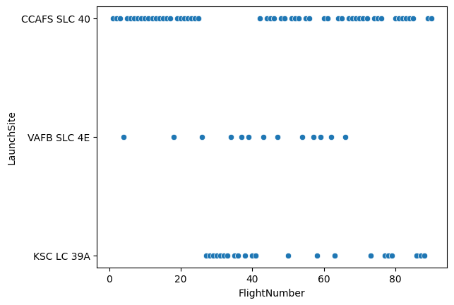
Flight Number vs. Launch Site
Most of the lunch were held on first lunch site “CCAFS SLC 40”
Second lunch site “VAFB SLC 4E” only made occasionally through out flight number
Third lunch site “ KSC LC 39A” were started to lumch from flight number starting from around 25.
Notes:
Show the screenshot of the scatter plot with explanations

Slide 19
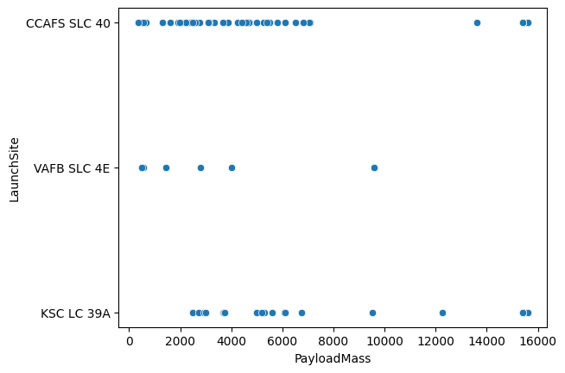
Payload vs. Launch Site
From the first lunch site “CCAFS SLC 40” most of the payload mass was below 8000kg while only 3 payload was out of bound.
Second lunch site “ VAFB SLC 4E” were tend to have distributed payload from 0 to 10000kg.

Slide 20
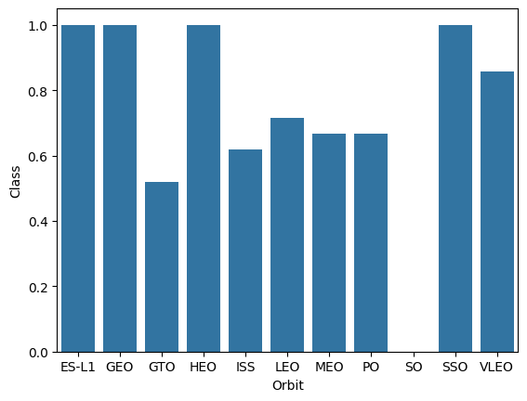
Success Rate vs. Orbit Type
The success rate of orbit ES-L1, GEO, HEO, SSO was 100% for all the lunches.
Orbit GTO, ISS, LEO, MEO, PO success rates varied from 50% to 70$ which is pretty low compares to the orbits above which scores 100% success rate

Slide 21
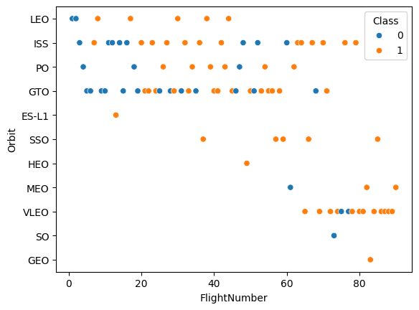
Flight Number vs. Orbit Type
When the flight number increases, the success rate increases as well.
For example, from flight number 60 till the end, only around 5 failures were found.
While flight numbers from 0-20, there are more failures than successes.

Slide 22
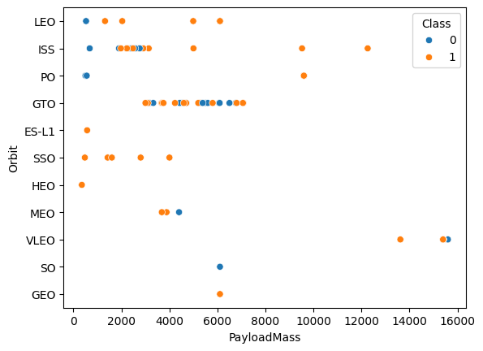
Payload vs. Orbit Type
From the plot above orbit vs success rate, GTO was doing worst and it seems reasonable that GTO has to highest density of the payload among the other orbit
The failures seem to vary all over the payload mass which might suggest that payload mass and success might not be correlated

Slide 23
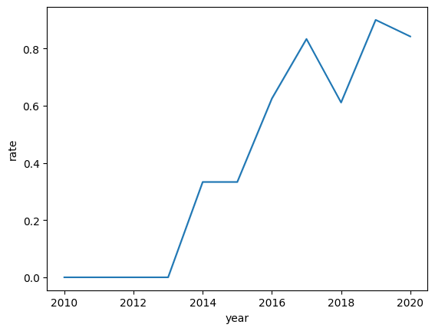
Launch Success Yearly Trend
The line plot clearly shows that the success rate increased by the year which was 0% from 2010 to 2013.
The success rate increases sharply from 2013 to 2017 reaching 80% from 0%.
From 2017 to 2020, the success rate varies from 60% to 90% which is a clear increase from 2010 to 2017.

Slide 24
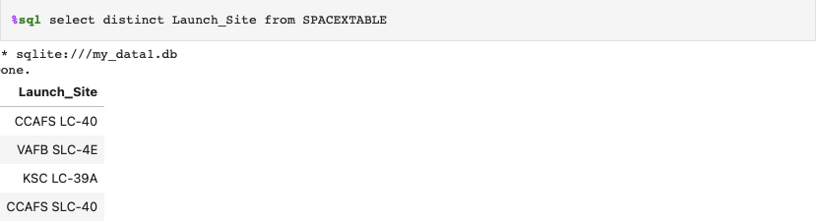
All Launch Site Names
All lunch site is “CCAFS LC -40”, “VAFB SLC-4E”, ”KSC LC-39A”, “CCAFS SLC-40”
Used ”distinct” query to extract the unique value from the columns “Launch_Site” from dataset SPACEXTABLE

Slide 25
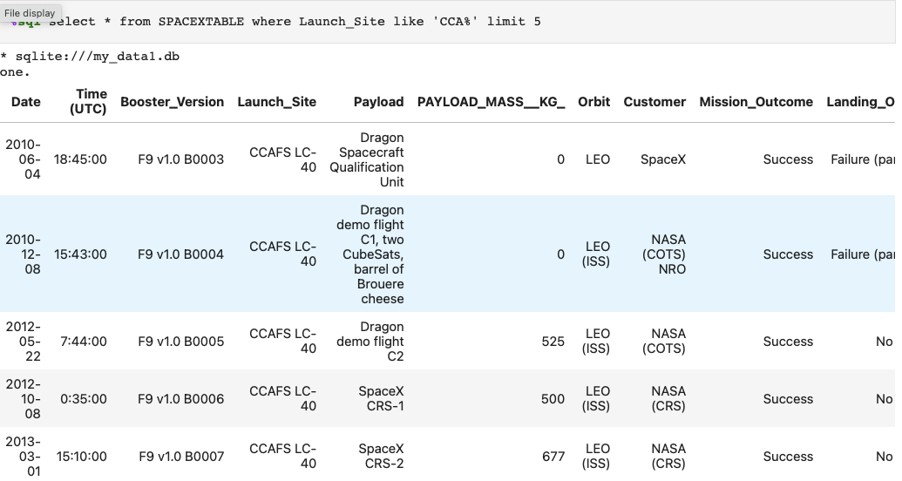
Launch Site Names Begin with 'CCA'
Used like “CCA%” that starts with CCA and limits 5 to present only the first 5 results.

Slide 26
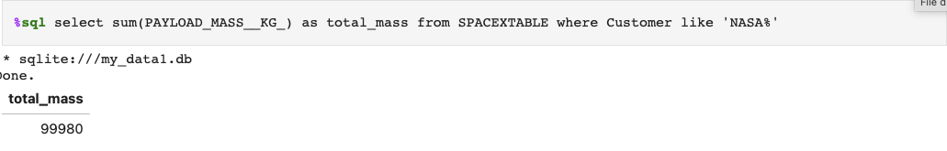
Total Payload Mass
Used sum() query to sum all the elements in the column “PAYLOAD_MASS” and used ”as” query to name the new column as ”total_mass”
Used ”NASA%” to fine the result start with NASA

Slide 27
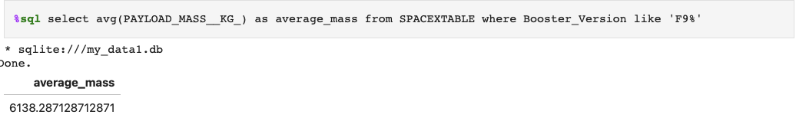
Average Payload Mass by F9 v1.1
Calculated the average payload mass carried by booster version F9 v1.1
Used avg() query to average the values from the column “PAYLOAD_MASS__KG_) and assigned the new name as “average_mass” by using the” as” query.
Also used the ”like” query with “F9%” so that capture the column name “Booster_Version” start with F9.

Slide 28
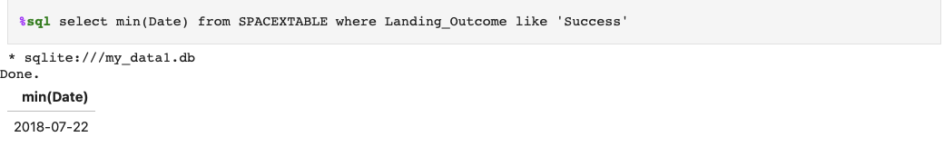
First Successful Ground Landing Date
Found the dates of the first successful landing outcome on ground pad
Used the “min()” query to min value of the “Date” column which would be considered as the first date where the “Landing_Outcome” is like ”Success”

Slide 29
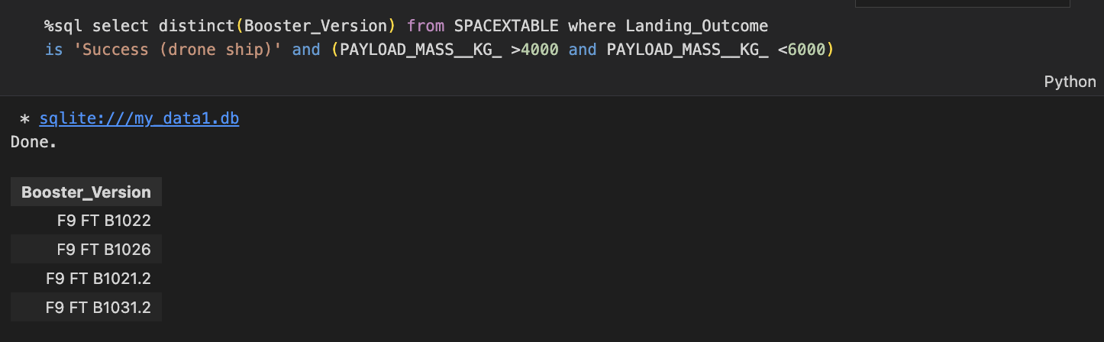
Successful Drone Ship Landing with Payload between 4000 and 6000
Listed the names of boosters which have successfully landed on drone ship and had payload mass greater than 4000 but less than 6000
Used after “where”, added ”is” to indicate the columns and specify the range needed, which is 4000 to 6000 using and.
(The screenshot is different because the query was too long to capture from GitHub so I have to capture it from visual studio )

Slide 30
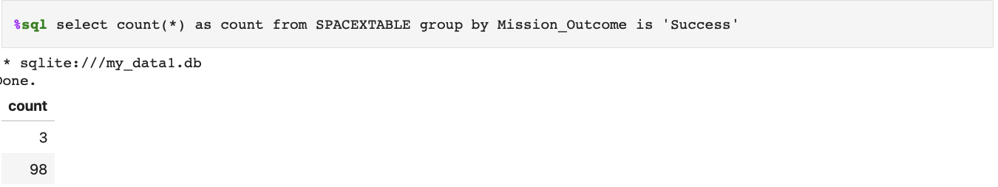
Total Number of Successful and Failure Mission Outcomes
Calculated the total number of successful and failure mission outcomes
Used “count()” function using “*” to count every rows from SPACEXTABLE and group them by “Mission_Outcome” columns where it is success

Slide 31
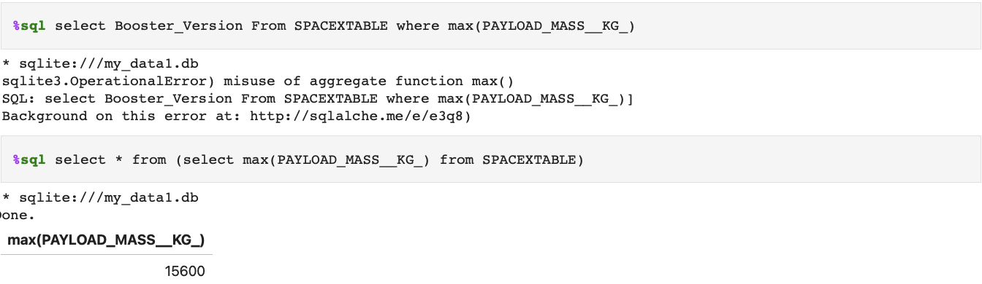
Boosters Carried Maximum Payload
Listed the names of the booster which have carried the maximum payload mass
First, extracted the “Booster_Version” with the maximum “PAYLOAD_MASS_KG_” and present the element

Slide 32
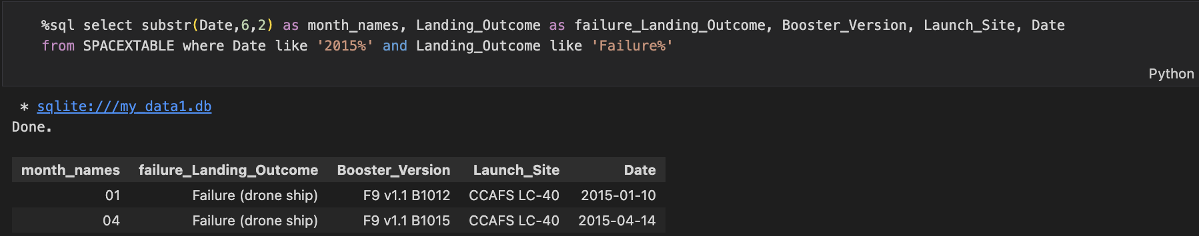
2015 Launch Records
Listed the failed landing_outcomes in drone ship, their booster versions, and launch site names for in year 2015
First, extract the Year from “Date” as ”month_names”
Extract the ”Landing_Outcome” as ”failure_Landing_Outcome”, and more columns from SPACEXTABLE, used “like” function to extract 2015 and failure from “Date” and “Landing_Outcome”

Slide 33
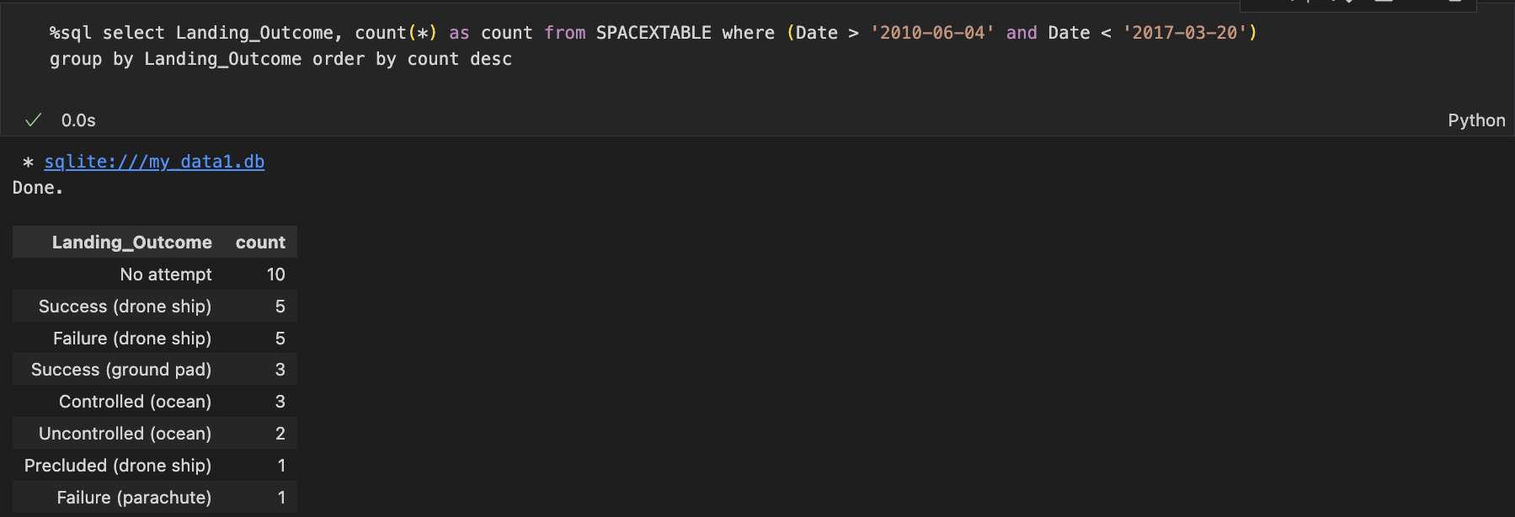
Rank Landing Outcomes Between 2010-06-04 and 2017-03-20
Ranked the count of landing outcomes (such as Failure (drone ship) or Success (ground pad)) between the date 2010-06-04 and 2017-03-20, in descending order
Used the ”group by” to extract distinct ”Landing_Outcome” and used “order by” function to make them descending order

Slide 34

Section 3

Slide 35
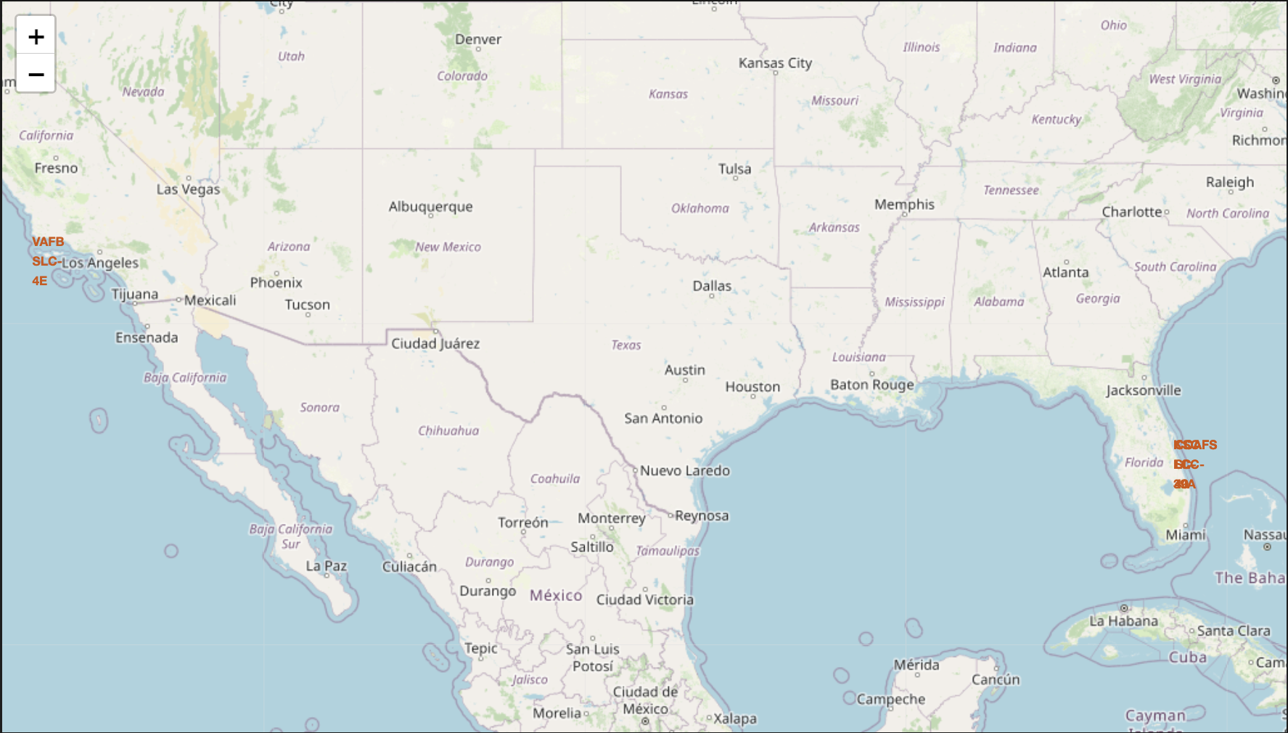
<All launch sites location markers on global map>
All launch sites in proximity to the Equator line
All launch sites in very close proximity to the coast

Slide 36
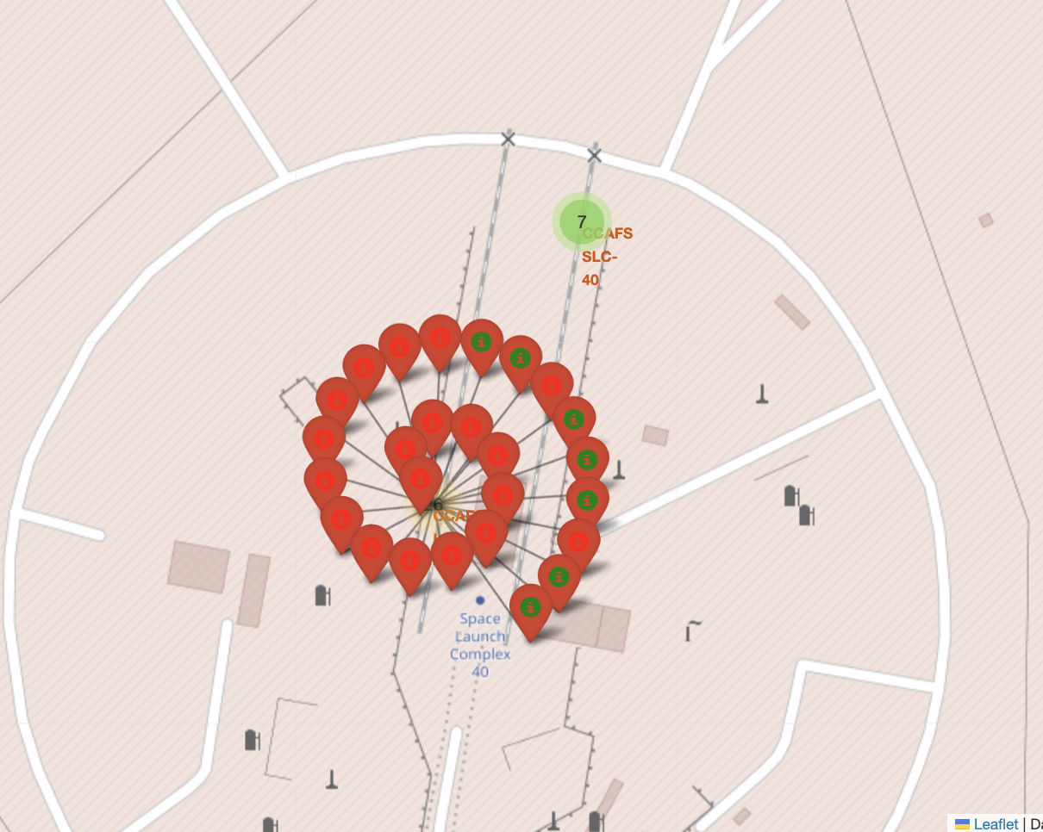
<Color-labeled launch outcomes>
The color labeled green a red
it is easier to identify the success
and failure from each launch sites
Also, the number of launches
for each launch sites

Slide 37
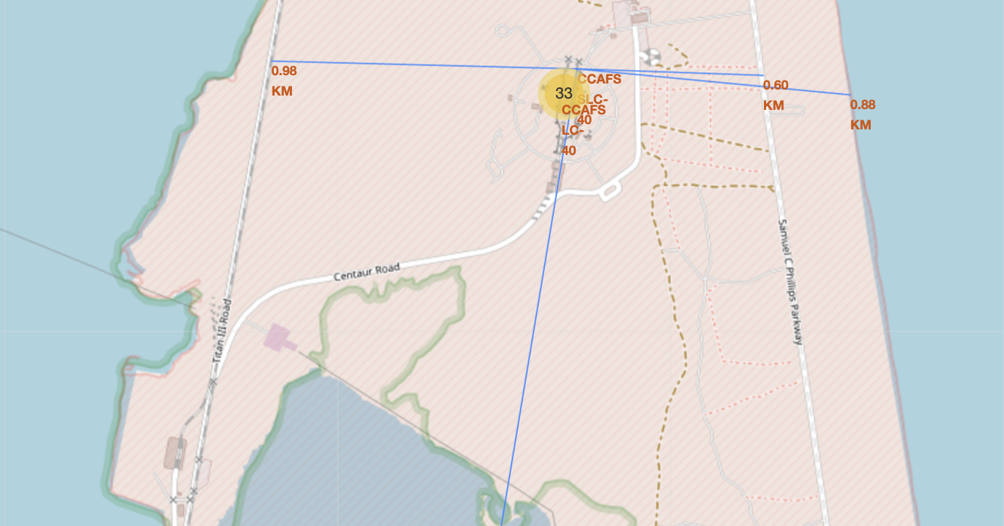
<Distance calculated to railway, highway, coastline>
The launch site is very close to railway, highway, and coastline
Also, the line toward the south side is toward the closest city. It makes sure that the launch site keeps certain distance between the city

Slide 38

Section 5

Slide 39
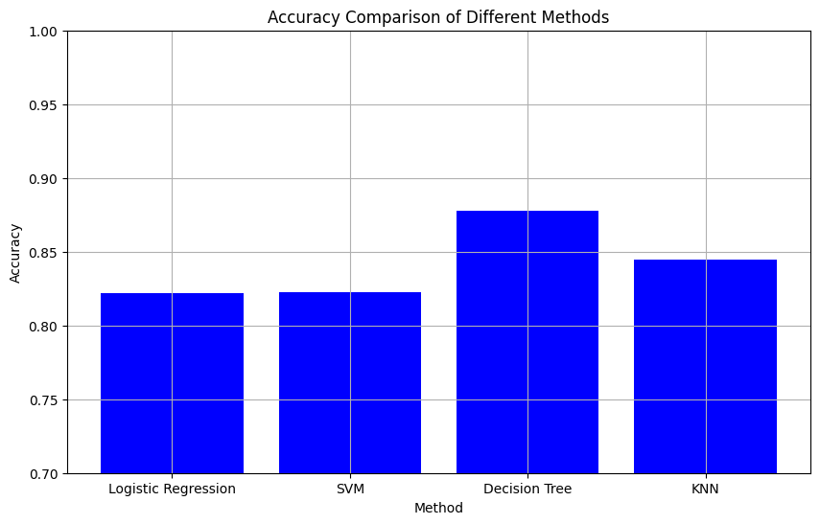
Classification Accuracy
The best model among logistic regression, SVM, Decision Tree, KNN is the Decision Tree method.
The decision tree method scores about 0.88

Slide 40
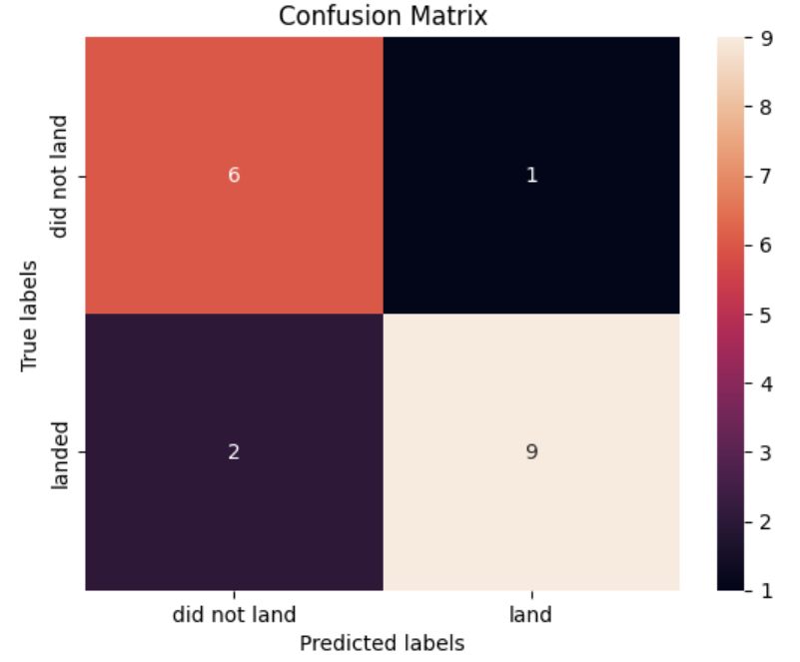
Confusion Matrix – Decision Tree
Confusion matrix of the decision tree model
This confusion matrix shows how accurate the true value is.
True labels and Predicted labels with bot did not land and land has much higher count than mismatch

Slide 41
Conclusions
From dataset related to spaceX, shows that the success rate of the payload is related to flight number which can be considered as a year or time.
Other than flight number, orbits, launch sites or payload mass do not seem to correlate to the success of the launches
Among logistic regression, SVM, decision tree, and KNN, by comparing the best accuracy for predicitoin, the decision tree shows the best score.
The above claim is supported by the confusion matrix of the decision tree.

Slide 42


